Slide 1

Object Oriented Concepts
Object-Oriented Programming
2301CS201
Prof. Swati R Sharma
Computer Engineering Department
swati.sharma@darshan.ac.in

Slide 2
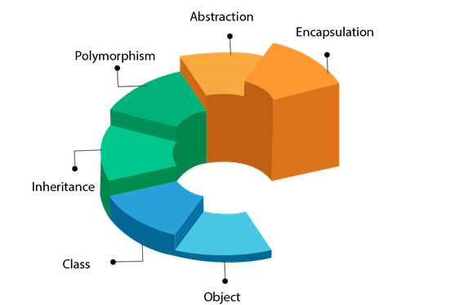
Principles of OOP

Slide 3

What is an Object?

Slide 4




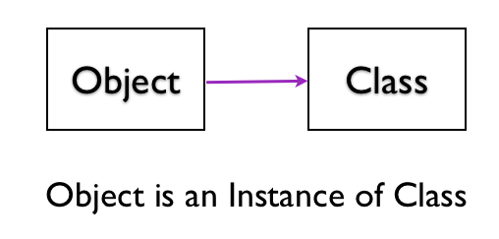
What is an Object?
An Object is an instance of Class.
An entity that has state and behavior is known as an object.
Means, they are created based on the class definition.
You can have multiple objects of the same class, each with its own unique data.
Each and every object posses
Identity
State
Behavior
OBJECT

Slide 5
Classes and Objects

Slide 6
Principles of OOP

Slide 7
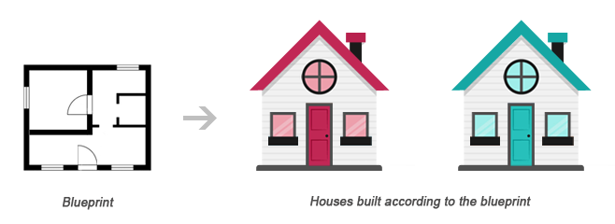
Classes and Objects
Class
Object1
Object2
Class is a blueprint of an object
Object is instance of class
Class describes the object

Slide 8
What is Class?
Class can be defined in multiple ways
A class is the building block.
A class is a blueprint for an object.
A class is a user-defined data type.
A class is a collection of objects of the similar kind.
A class is a user-defined data type which combines data and methods.
A class describes both the data and behaviors of objects.
Class contains data members (also known as field or property or data) and member functions (also known as method or action or behavior)
Classes are similar to structures in C.

Slide 9
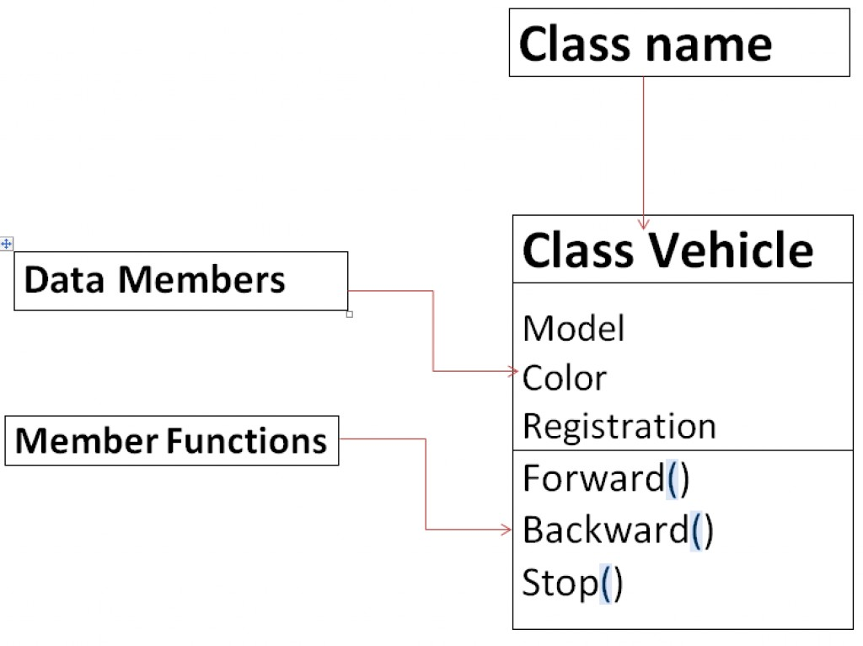
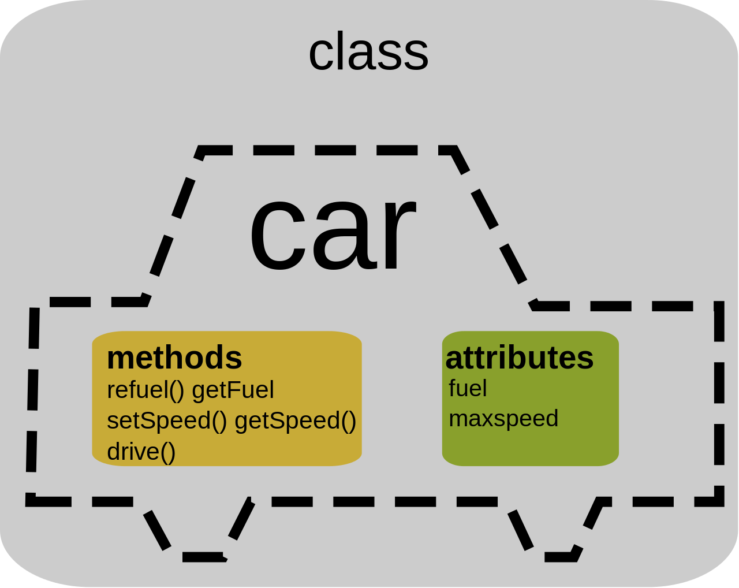
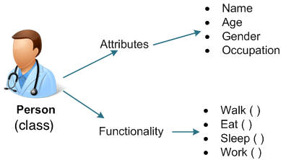
What does a Class Contain?

Slide 10
Points to Remember for Class and Object
When a class is defined, only the specification or blueprint for the object is defined; no memory or storage is allocated.
When an object of a class is declared, the memory is allocated as per the data members of a class
We can access the data members and member functions of a class by using a . (dot) operator.
Generally Class contains
Data Members
Member Functions
Constructor (Special Member Function)

Slide 11

LMS

Slide 12






Class and Objects
CAR
Audi | Lamborghini | Benz | Toyota | Ferrari

Slide 13
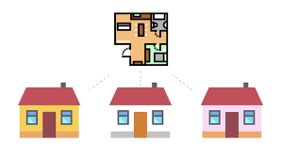
Class and Objects

Slide 14
Class and Objects
Object 1
Person: P1
Name: Narendra Modi
Gender: Male
Age: 71 Years
Profession: Politician
Class
Person
Person: P1
Name
Gender
Age
Profession
Object 2
Person: P2
Person: P2
Name: Amitabh Bachchan
Gender: Male
Age: 79 Years
Profession: Actor

Slide 15
Class and Objects
Object 1
BankAccount: B1
Account_No: 1001123001
balance: 1,00,000
Class
BankAccount: B1
BankAccount
Object 2
Account_No
balance
BankAccount: B2
BankAccount: B2
Account_No: 1001123002
balance: 5,60,0000
BankAccount: B3
Object 3
BankAccount: B3
Account_No: 1001123003
balance: 10,000

Slide 16
Class and Objects
Object 1
Cube : C1
Name:C1
Height:20cm
Width:20cm
Depth:20cm
Class
Cube : C1
Cube
Object 2
Name
Height
Width
Depth
Cube : C2
Name: C2
Height:5cm
Width:5cm
Depth:5cm
Cube : C2
Cube : C3
Object 3
Cube : C3
Name: C3
Height:10cm
Width:10cm
Depth:10cm

Slide 17
Class and Objects
Person
name
employee of
Company
companyName
Class Diagram
*
*
John:Person
name
employee of
IBM:Company
companyName
Parth:Person
name
Object Diagram
Jaya:Person
name
employee
of
TCS:Company
companyName
Amy:Person
name

Slide 18
Class and Objects
Country
countryName
has
CapitalCity
cityName
Class Diagram
1
1
India:Country
countryName
has
NewDelhi:CapitalCity
cityName
Canada:Country
countryName
has
Ottawa:CapitalCity
cityName
Object Diagram
France:Country
countryName
has
Paris:CapitalCity
cityName
Japan:Country
countryName
has
Tokyo:CapitalCity
cityName

Slide 19
Creating Object & Accessing members
new keyword creates new object
Syntax:
ClassName objName = new ClassName();
Example :
SmartPhone iPhone = new SmartPhone();
Object variables and methods can be accessed using the dot (.) operator
Example:
iPhone.storage = 8000;

Slide 20
class Box {
double length;
double breadth;
double height;
}
class BoxDemo {
public static void main(String args[]) {
Box myBox1 = new Box();
Box myBox2 = new Box();
double vol;
myBox1.length = 10;
myBox1.breadth = 20;
myBox1.height = 30;
myBox2.length = 3;
myBox2.breadth = 6;
myBox2.height = 9;
vol = myBox1.length * myBox1.breadth * myBox1.height;
System.out.println("Volume is " + vol);
vol = myBox2.length * myBox2.breadth * myBox2.height;
System.out.println("Volume is " + vol);
}
}
length = 10
length
myBox1
breadth = 20
breadth
height = 30
height
length
length = 3
myBox2
breadth = 6
breadth
height = 9
height

Slide 21
Declaring an Object
MyProg.java
class Square{
double height;
double width;
}
class MyProg{
public static void main(String[] args) {
}
}
An object reference is
similar to a memory pointer.
reference
NULL
s1
Square s1; //declare reference to object
s1= new Square();//allocate a Square object
Allocates
Memory
at Runtime
height
width
new operator dynamically allocates memory for an object
Here, s1 is a variable of the class type.
The class name followed by parentheses specifies the constructor for the class.
It is important to understand that new allocates memory for an object during run time.
s1

Slide 22
Class vs. Object
Class | Object
Class is a Blueprint or template. | Object is the instance of a class.
Class creates a logical framework that defines the relationship between its members. | When you declare an object of a class, you are creating an instance of that class.
Class is a logical construct. | An object has physical reality. (i.e., an object occupies space in memory.)
Class is a group or collection of similar object. e.g. Car | An Object is defined as real-world entity e.g.:Audi, Volkswagen, Tesla, Ferrari etc.
Class is declared only once | An Object can be created as many times as required
Class doesn’t allocate memory when it is created. | An Object allocates the memory upon creation
Class can exist without its objects. | An Object can’t exist without a class.
Class: Profession Class: Mobile Class: Subject Class: Student Class: Color | Object: Doctor, Teacher, Lawyer, Politician… Object: iPhone, Samsumg, 1plus… Object: Maths, English, Science, Computer… Object: John, Aarav, Smita… Object: Blue, Green, Red, Yellow, Violet, Black…

Slide 23
Pillars of OOP
Inheritance
Polymorphism
Encapsulation
Abstraction

Slide 24

Encapsulation
Program
Encapsulation
Class
{
Data Members(e.g. int a=10)
+
Methods(e.g. add() )
}
Variables/Data Members
Class
The action of enclosing something in.
In OOP, encapsulation refers to the bundling of data with the methods.
Methods()

Slide 25
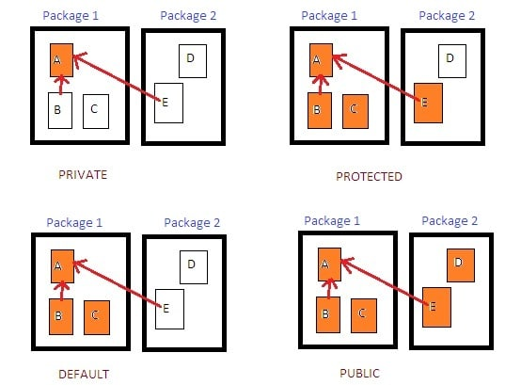
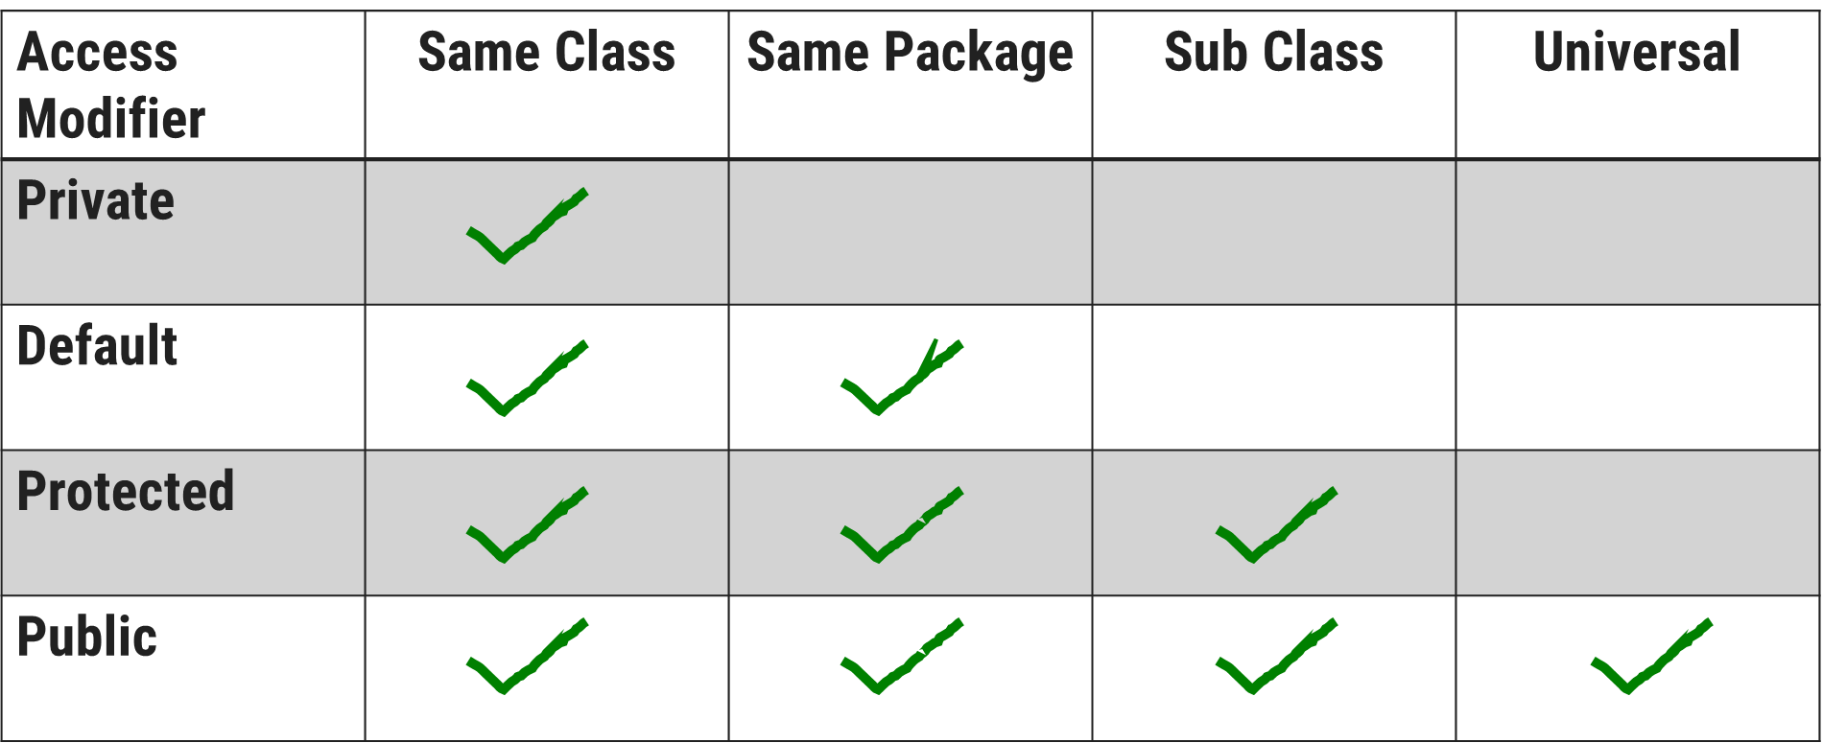
Encapsulation: Access Specifier

Slide 26
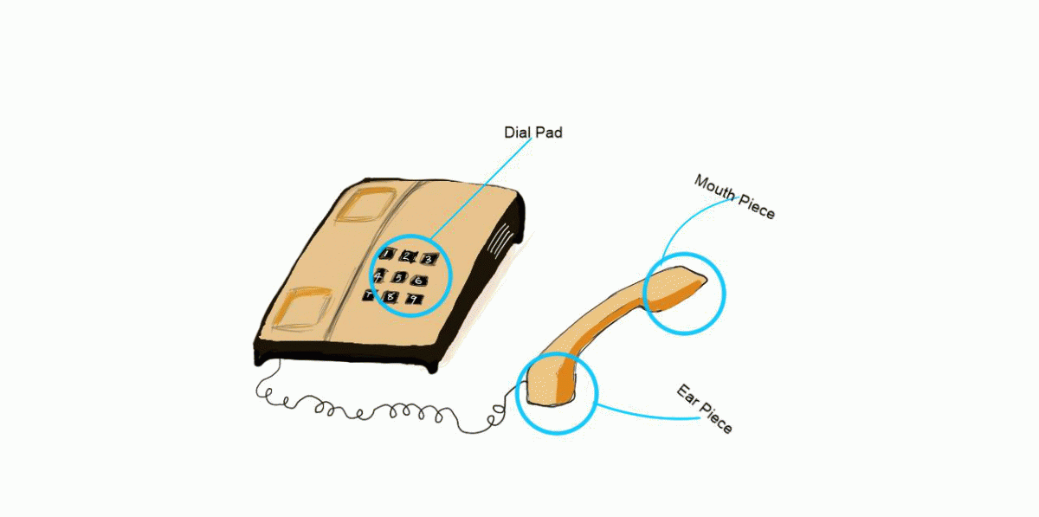
Encapsulation

Slide 27
Encapsulation
Program
Encapsulation
Class
{
Data Members(e.g. int a=10)
+
Methods(e.g. add() )
}
Variables/Data Members
Class
The action of enclosing something in.
In OOP, encapsulation refers to the bundling of data with the methods.
Methods()

Slide 28
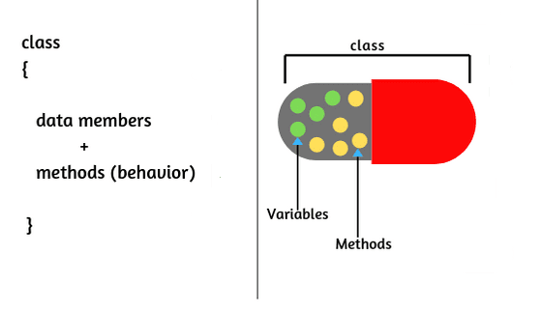
Encapsulation
The wrapping up of data and functions into a single unit is known as encapsulation
The insulation of the data from direct access by the program is called data hiding or information hiding.
It is the process of enclosing one or more details from outside world through access right.
Advantages
Protects an object from unwanted access
It reduces implementation errors.
Simplifies the maintenance of the application and makes the application easy to understand.
Protection of data from accidental corruption.

Slide 29

Constructor

Slide 30

Default Constructor: MyConst.java
class MyConst {
public static void main(String[] args) {
MyConst c=new MyConst();
}
}
Compiler
After Compilation
class MyConst{
MyConst(){
//Default Constructor…
}
public static void main(String[] args) {
c=new MyConst();
}
}

Slide 31
Types of Constructor
Constructor
Default
No-Argument
Parameterized
Copy Constructor

Slide 32
Parameterized Constructor

Slide 33
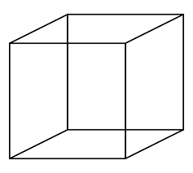
Parameterized Constructor: MyMain.java
class Cube {
double width, height, depth;
Cube(double w, double h, double d)
{ System.out.println(" Constructing cube");
width = w;
height = h;
depth = d;
}//Cube()
}//class
class MyMain{
public static void main(String[] args){
Cube c=new Cube(10,10,10);
}
}

Slide 34
Constructor Overloading
In addition to overloading normal methods, you can also overload constructor methods.
class Balance{
int accNo;
double bal;
Balance(){
System.out.println("inside const1");
bal=0;
}
Balance(double b){
System.out.println("inside const2");
bal=b;
}
Balance(int a,double b){
System.out.println("inside const3");
bal=b;
accNo=a;
}
}
class Account{
public static void main(String args[]){
Balance b1= new Balance();
Balance b2= new Balance(100);
Balance b3=new Balance(1201,10000);
System.out.println("b1.bal="+b1.bal);
System.out.println("b2.bal="+b2.bal);
System.out.println("b3.bal="+b3.bal+ "b3.accNo="+b3.accNo);
}
}

Slide 35
Copy Constructor
It is a special type of constructor that is used to create a new object using the existing object of a class that had been created previously.
It creates a new object by initializing the object with the instance of the same class.
Constructor 1()
{
…
}
Constructor 2(Constructor 1)
{
…
}
Copy Constructor

Slide 36
Copy Constructor: MyProgramCopy.java
class Student{
String name;
int rollno;
Student(String s_name, int s_roll){
System.out.println("ConstructorInvoked");
this.name=s_name;
this.rollno=s_roll;
} //Constructor1
Student(Student s){ //CopyConstructor
System.out.println("CopyConstructor Invoked");
this.name=s.name;
this.rollno=s.rollno;
} //Constructor2
public void display(){
System.out.print("name="+name);
System.out.println(" rollno="+rollno);
} // display()
} //class
class MyProgramCopy {
public static void main(String[] args){
Student s1=new Student("darshan",101);
//invoking Copy Constructor
Student s2=new Student(s1);
s1.display();
s2.display();
} //main()
} //class myProgram
Output
Constructor Invoked
CopyConstructor Invoked
name=darshan rollno=101
name=darshan rollno=101

Slide 37
Passing Objects as Argument
In order to understand how and why we need to pass object as an argument in methods, lets see the below example.
class Time{
int hour;
int minute;
int second;
public Time(int hour, int minute, int second) {
this.second = second;
this.minute = minute;
this.hour = hour;
}
void add(Time t) {
this.second += t.second;
if(this.second>=60) {
this.minute++;
this.second-=60;
}
this.minute += t.minute;
if(this.minute>=60) {
this.hour++;
this.minute-=60;
}
this.hour += t.hour;
}
}
public class TimeDemo {
public static void main(String[] args) {
Time t1 = new Time(11,59,55);
Time t2 = new Time(0,0,5);
t1.add(t2);
System.out.println(t1.hour + ":" + t1.minute + ":" + t1.second);
}
}

Slide 38
Constructor() vs. Method()
 | Constructor() | Method()
Naming | Constructor name must be same as class name. | Method name can be anything.
Return types | Constructor does not have any return type, not even void. | Method must have return types, at least void.
Call | Constructor can be invoked implicitly when object is created. | Method is called by the programmer. Invoked explicitly.
Purpose | To initialize an object | To execute the code
Inheritance | Constructor cannot be inherited by subclass. Super is used to call superclass constructor | Method can be inherited by subclass.

Slide 39

‘this’ keyword
this

Slide 40
class Box {
double length;
double breadth;
double height;
Box(double l, double b, double h) {
System.out.println("Constructing Box");
length = l;
breadth = b;
height = h;
}
void volume() {
double volume = length * breadth * height;
System.out.println("Volume is " + volume);
}
}
class BoxDemo {
public static void main(String args[]) {
Box myBox1 = new Box(10,20,30);
Box myBox2 = new Box(3,6,9);
myBox1.volume();
myBox2.volume();
}
}
Box(double length, double breadth, double height) {
this.length = length;
this.breadth = breadth;
this.height = height;
length = length;
breadth = breadth;
height = height;
Creates ambiguity for compiler
length is instance variable as well as length is formal parameter of method

Slide 41
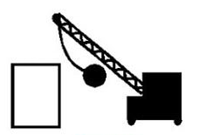
Destructor

Slide 42
Pillars of OOP
Inheritance
Polymorphism
Encapsulation
Abstraction

Slide 43
Inheritance
Definition-1: “The mechanism of a class to derive properties and characteristics from another class is called Inheritance. “
Definition-2: “Inheritance is the process, by which class can acquire(reuse) the properties and methods of another class.”
It is the most important feature of Object Oriented Programming.
Base Class: The class whose properties are inherited by sub class is called Base Class/Super class/Parent class.
Derived Class: The class that inherits properties from another class is called Sub class/Derived Class/Child class.
Inheritance is implemented using super-class and sub-class relationship in object-oriented languages.
Base Class
Derived Class

Slide 44
Inheritance
class Person is called Base class
class Person
Attributes:
Age, Height, Weight
Methods:
Talk() , Walk(), Eat()
class Doctor
class Footballer
class Businessman
Methods:
Diagnose()
Methods:
Playfootball()
Methods:
Runbusiness()
These classes are called Derived class

Slide 45
Inheritance
class Vehicle
Attributes:
Engine_no, color
Methods:
apply_breaks()
class Car
class Bus
class Truck
Attributes:
Private_vehicle
Attributes:
Public_vehicle
Attributes:
Goods_vehicle

Slide 46
Property of Inheritance
A class member that has been declared as private will remain private to its class. It is not
accessible by any code outside its class, including subclasses.
Base class A can’t access attributes and methods of Derived Class B
Class A
Base Class
Derived Class B can’t access private members of Base class A
Class B
Derived Class
Derived Class B can access attributes and methods of Base class A

Slide 47
Types of Inheritance in Java
1. Single Inheritance
2. Hierarchical Inheritance
3. Multilevel Inheritance
A
A
A
B
B
C
B
C
4. Multiple Inheritance
5. Hybrid Inheritance
A
B
A
Note: Multiple and Hybrid Inheritance is not supported in Java with the Class Inheritance, we can still use those Inheritance with Interface which we will learn in later part of the Unit
B
C
C
D

Slide 48

Implementing Inheritance
Subclass-Superclass Relationship

Slide 49
Implementing Inheritance in java
class A
{
//SuperClass or ParentClass or BaseClass
}
Class A
Base Class
the keyword “extends” is used to create a subclass of A
class B extends A
{
//SubClass or ChildClass or DerivedClass
}
Class B
Derived Class

Slide 50
Inheritance: Advantages
Promotes reusability
When an existing code is reused, it leads to less development and maintenance costs.
It is used to generate more dominant objects.
Avoids duplicity and data redundancy.
Inheritance makes the sub classes follow a standard interface.
Base Class
Derived Class

Slide 51
Super Keyword

Slide 52
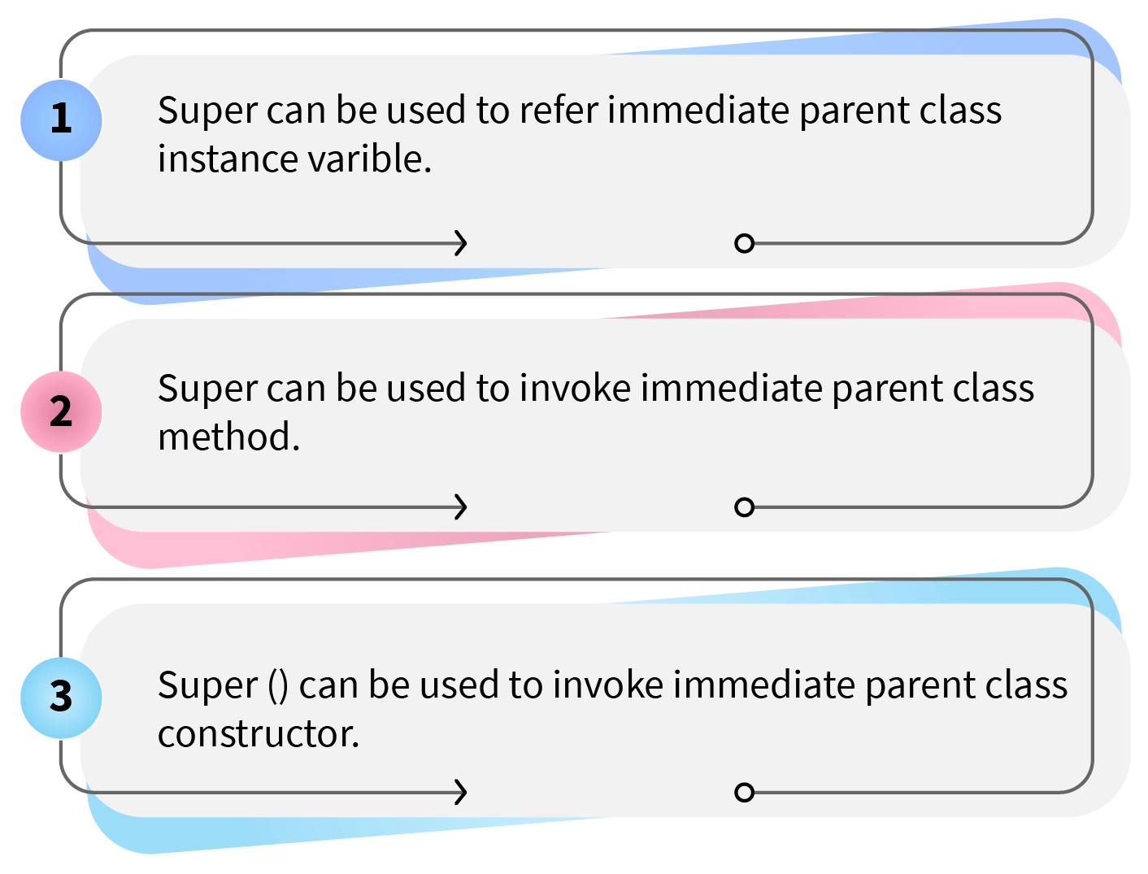
Super Keyword
Whenever a subclass needs to refer to its immediate superclass, it can do so by use of the keyword super. Super has two general forms:
Calls the superclass constructor.
Used to access a members(i.e. instance variable or method) of the superclass.

Slide 53
Using super to access members
The second form of super acts somewhat like this, except that it always refers to the superclass of the subclass in which it is used.
Syntax:
This second form of super is most applicable to situations in which member names of a subclass hide members by the same name in the superclass.
member can be either a method or an instance variable.
super.member

Slide 54
Using super to access members: SuperMemberDemo.java
class A{
}
class B extends A{
int i,k;
B(int a,int b){
this.i=b;
}
void show(){
System.out.println("super.i="+super.i);
System.out.println("this.i="+this.i);
}
}
class SuperMemberDemo{
public static void main(String[] args)
{
B b= new B(12,56);
b.show();
}
}
int i;
super.i=a;
Output
super.i=12
this.i=56

Slide 55
Using super to access members: SuperMemberDemo.java
class A{
int i=33;
void show(){
System.out.println("inside A:i="+i);
}
}
class B extends A{
int i,k;
B(int a,int b){
super.show();
super.i=a;
this.i=b;
}
void show(){
System.out.println("super.i="+super.i);
System.out.println("this.i="+this.i);
}
}
class SuperMemberDemo{
public static void main(String[] args)
{
B b= new B(12,56);
b.show();
}
}
Output
inside A:i=33
super.i=12
B.i=56

Slide 56
class Cube{
protected double height,width,depth;
Cube(double h,double w,double d){
System.out.println("Constructor:
CUBE");
height=h;
width=w;
depth=d;
}
}
class CubeInheritSuper{
public static void main(String[] args) {
CubeWeight cw1= new CubeWeight(10,10,10,20.5);
CubeWeight cw2= new CubeWeight(100,100,100,200.5);
}
}
class CubeWeight extends Cube{
double weigth;
CubeWeight(double h,double w,double d, double m){
super(h,w,d); //call superclassConstructor
System.out.println("Constructor:CUBEWEIGTH");
weigth=m;
}
}
Using super to Call Superclass Constructors

Slide 57
Points to remember for Super Keyword
When a subclass calls super( ), it is calling the constructor of its immediate superclass.
This is true even in a multileveled hierarchy.
super( ) must always be the first statement executed inside a subclass constructor.
If a constructor does not explicitly call a superclass constructor, the Java compiler automatically inserts a call to the no-argument constructor of the superclass.
The most common application of super keyword is to eliminate the ambiguity between members of superclass and sub class.

Slide 58
Inheritance: Interview Questions
Which class in Java is superclass of every other class?
Can a class extend itself?
Can we assign superclass to subclass?
Can a class extend more than one class?

Slide 59
Pillars of OOP
Inheritance
Polymorphism
Encapsulation
Abstraction

Slide 60
Polymorphism

Slide 61

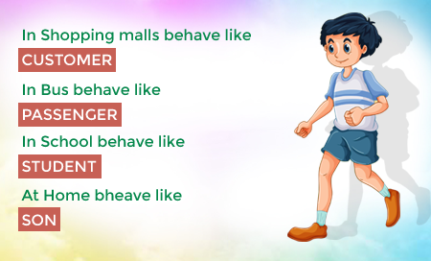



Polymorphism
Polymorphism: It is a Greek term means, “One name many Forms”
Polymorphism
Poly:
Many
Morphism:
Types
Most important concept of object oriented programming
In OOP, Polymorphism is the ability of an object to take on many forms.

Slide 62
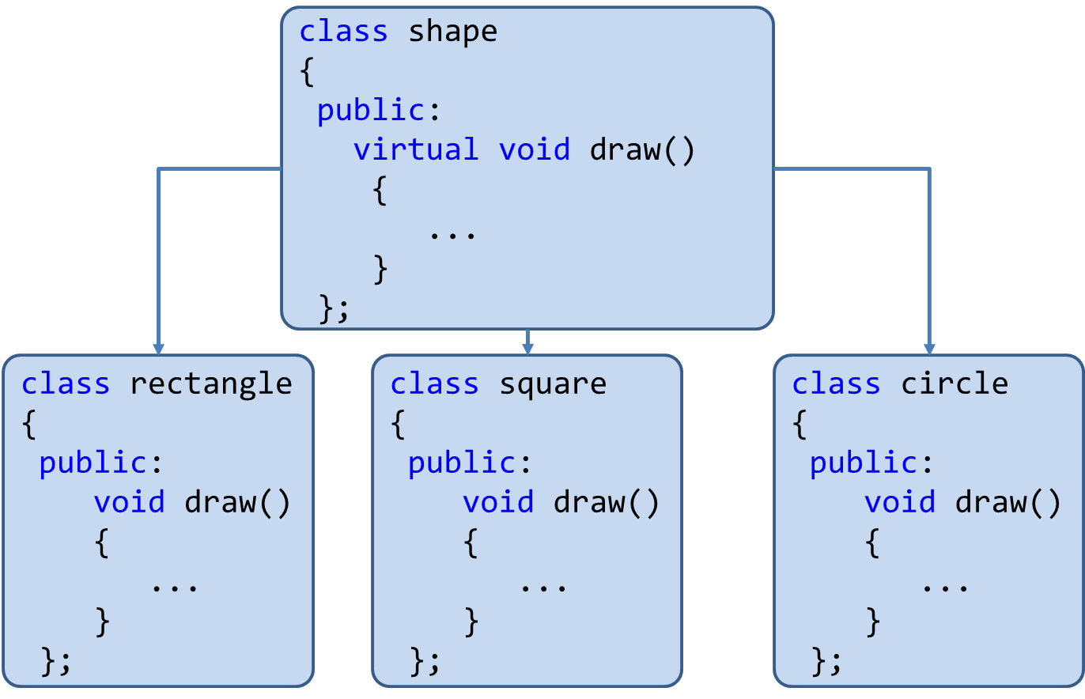
Polymorphism: Advantages
Single variable can be used to store multiple data types.
Easy to debug the codes.
It allows to perform a single act in different ways.
Polymorphism allows the object to decide which form of the function to implement at compile-time (overloading) as well as run-time (overriding).
Increases reusability and makes code easier to read.

Slide 63
Implementing Polymorphism
Polymorphism
Using
Method Overloading
Using
Method Overriding

Slide 64
Method Overloading: Compile-time Polymorphism
class OverloadDemo{
public static void main(String[] args){
Addition a1= new Addition();
//call all versions of add()
a1.add(20);
a1.add(30,50);
a1.add(10,30,60);
}
}
class Addition{
int i,j,k;
void add(int a){
i=a;
System.out.println("add i="+i);
}
void add(int a,int b){\\overloaded add()
i=a;
j=b;
System.out.println("add i+j="+(i+j));
}
void add(int a,int b,int c){\\overloaded add()
i=a;
j=b;
k=c;
System.out.println("add i+j+k="+(i+j+k));
}
}
Output
add i=20
add i+j=80
add i+j+k=100

Slide 65
Method Overriding: OverrideDemo.java
class OverrideDemo{
public static void main(String[] args) {
Circle c= new Circle();
c.draw(); //child class meth()
Square sq= new Square();
sq.draw();//child class meth()
Shape sh= new Shape();
sh.draw();//parentClass meth()
}
}
class Shape{
void draw(){
System.out.println("Draw Shape");
}
}
class Circle extends Shape{
void draw(){
System.out.println("Draw Circle");
}
}
class Square extends Shape{
void draw(){
System.out.println("Draw Square");
}
}
When an overridden method is called from within a subclass, it will always refer to the version of that method defined by the subclass. The version of the method defined by the superclass will be hidden.
Output
Draw Circle
Draw Square
Draw Shape

Slide 66
Overloading vs Overriding: Java Methods
Method Overloading | Method Overriding
Overloading: Method with same name different signature | Overriding: Method with same name same signature
Known as Compile-time Polymorphism | Known as Run-time Polymorphism
It is performed within class. | It occurs in two/more classes with IS-A (inheritance) relationship.
Inheritance and method hiding is not involved here. | Here subclass method hides the super class method.

Slide 67
Dynamic Method Dispatch
Dynamic method dispatch is the mechanism by which a call to an overridden method is resolved at run time, rather than compile time.
Dynamic method dispatch is important because this is how Java implements run-time polymorphism.
A
Parent Class
A a = new A(); //object of parent class
B b = new B(); //object of child class
A a = new B();
//Up casting(Dynamic Method Dispatch)
B b= new A();
//Error! Not Allowed
B
Child Class

Slide 68
Method Overloading: Points to remember
Can we overload java main() method?
Yes, by method overloading. We can have any number of main methods in a class by method overloading
But JVM calls main() method which receives string array as arguments only.

Slide 69
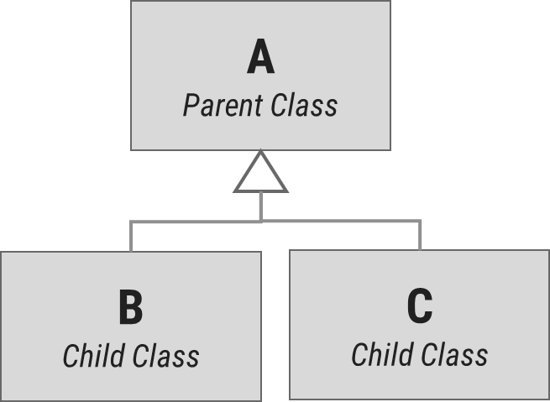
Dynamic Method Dispatch: Example
class A{
void display(){
System.out.println("inside class A");
}
}
class B extends A{
void display(){
System.out.println("inside class B");
}
}
class C extends A{
void display(){
System.out.println("inside class C");
}
}
class DispatchDemo{
public static void main(String[] args) {
A a = new A();
B b = new B();
C c = new C();
A r; //obtain a reference of type A
r=a;
r.display();
r=b;
r.display();
r=c;
r.display();
}
}
Output
inside class A
inside class B
inside class C
Dynamic binding occurs during run-time known as Run-time Polymorphism.

Slide 70
Dynamic Method Dispatch: Example
class Game {
public void type() {
System.out.println("Indoor & outdoor");
}
}
class Cricket extends Game {
public void type() {
System.out.println("outdoor game");
}
}
class Badminton extends Game {
public void type() {
System.out.println("indoor game");
}
}
class Tennis extends Game {
public void type() {
System.out.println("Mix game");
}
}
public class MyProg {
public static void main(String[] args) {
Game g = new Game();
Cricket c = new Cricket();
Badminton b = new Badminton();
Tennis t = new Tennis();
Scanner s = new Scanner(System.in);
System.out.print("Please Enter name of the game = ");
String op = s.nextLine();
if (op.equals("cricket")) {
g = c;
} else if (op.equals("badminton")) {
g = b;
} else if (op.equals("tennis")) {
g = t;
}
g.type();
}
}

Slide 71
Static

Slide 72
Static in java
Static in Java
Static Variable
Static Method
Static Block
Static Class

Slide 73
class Student {
int rollNo;
String name;
.
.
.
}
static String college = "DIET";
String college = "DIET";
class StudentDemo {
public static void main(String args[]) {
Student student1 = new Student();
Student student2 = new Student();
Student student3 = new Student();
.
.
.
}
}
student1
student2
student3
rollNo
name
college
DIET
DIET
DIET
college
DIET

Slide 74
Example: Static Block, Method and Variable
class StaticDemo {
static int a = 4; //static variable declared & initialized
static int b; //static variable declared
static void dispValue(int x) {
System.out.println("Static method initialized.");
System.out.println("x = " + x);
System.out.println("a = " + a);
System.out.println("b = " + b);
} //static method
static {
System.out.println("Static block initialized.");
b= a * 5;
} //static block
public static void main(String args[]) {
System.out.println("inside main()...");
dispValue(44);
} //main()
} //class
3
1
Output
Static block initialized.
inside main()...
Static method initialized.
x = 44
a = 4
b = 20
2

Slide 75
Nested Class

Slide 76
Nested Class
Nested Class: Class within another class
Scope: Nested class is bounded by the scope of its enclosing class.
E.g. class B is defined within class A, then B is known to A, but not outside of A.
A nested class has access to the members, including private members of the class in which it is nested.
However, the enclosing class does not have access to the members of the nested class. i.e. Class B can access private member of class A, while reverse is not accessible.
A: Outer Class
B: Nested
Class

Slide 77
Nested Class
Types of Nested class:
Nested Class
Static
Nested Class
Non- Static
Nested Class

Slide 78
Non-Static Nested Class: InnerOuterDemo.java
class Outer{
private int a=100;//instance variable
void outerMeth(){
Inner i= new Inner();
System.out.println("inside outerMeth()...");
i.innerMeth();
}
class Inner{
int b=20;
void innerMeth(){
System.out.println("inside innerMeth()..."
+(a+b));
}
} //inner class
} //outer class
class InnerOuterDemo{
public static void main(String[] args)
{
Outer o= new Outer();
o.outerMeth();
}
} //InnerOuterDemo
Output
inside outerMeth()...
inside innerMeth()...120

Slide 79
Static Nested Class: InnerOuterDemo
class Outer{
void outerMeth(){
Inner i= new Inner();
System.out.println("inside outerMeth()...");
i.innerMeth();
}
static class Inner{
int b=20;
void innerMeth(){
System.out.println("inside innerMeth()..."
+(a+b));
}
} //inner class
} //outer class
error: non-static variable a cannot be referenced from a static context
static int a=100;
class InnerOuterDemo{
public static void main(String[] args)
{
Outer o= new Outer();
o.outerMeth();
}
} //InnerOuterDemo
int a=100;//instance variable
Output
inside outerMeth()...
inside innerMeth()...120

Slide 80
Points to remember for static keyword
When we declare a field static, exactly a single copy of that field is created and shared among all instances of that class.
Static variables belong to a class, we can access them directly using class name. Thus, we don't need any object reference.
We can only declare static variables at the class level.
We can access static fields without object initialization.
Static methods can't be overridden.
Abstract methods can't be static.
Static methods can't use this or super keywords.
Static methods can't access instance variables and instance methods directly. They need some object reference to do so.
A class can have multiple static blocks.

Slide 81

Final
The Unmodified Shield!

Slide 82
“final” keyword
The final keyword is used for restriction.
final keyword can be used in many context
Final can be:
Variable
If you make any variable as final, you cannot change the value of final variable(It will be constant).
Method
If you make any method as final, you cannot override it.
Class
If you make any class as final, you cannot extend it.

Slide 83
1) “final” as a variable
Can not change the value of final variable.
public class FinalDemo {
final int speedlimit=90;//final variable
void run(){
speedlimit=400;
}
public static void main(String args[]){
FinalDemo obj=new FinalDemo();
obj.run();
}
}
final

Slide 84
2) “final” as a method
If you make any method as final, you cannot override it.
class BikeClass{
final void run(){
System.out.println("Running Bike");
}
}
class Pulsar extends BikeClass{
void run(){
System.out.println("Running Pulsar");
}
public static void main(String args[]){
Pulsar p= new Pulsar();
p.run();
}
}
final

Slide 85
3) “final” as a Class
If you make any class as final, you cannot extend it.
final
final class BikeClass{
void run(){
System.out.println("Running Bike");
}
}
class Pulsar extends BikeClass
{
void run(){
System.out.println("Running Pulsar");
}
public static void main(String args[]){
Pulsar p= new Pulsar();
p.run();
}
}

Slide 86
Pillars of OOP
Inheritance
Polymorphism
Encapsulation
Abstraction

Slide 87
Abstraction

Slide 88


Abstraction
Data abstraction is also termed as information hiding.
Abstraction is the concept of object-oriented programming that “represents” only essential attributes and “hides” unnecessary information.
Abstraction is all about representing the simplified view and avoid complexity of the system.
It only shows the data which is relevant to the user.
In object-oriented programming, it can be implemented using Abstract Class.
Advantage:
It reduces programming complexity.
Example:
A car is viewed as a car rather than its
numerous individual components.

Slide 89
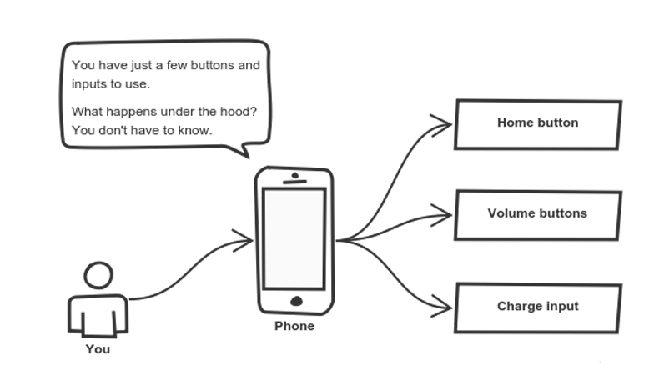
Abstraction

Slide 90
Abstraction vs. Encapsulation

Slide 91
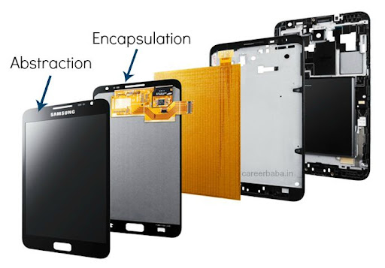
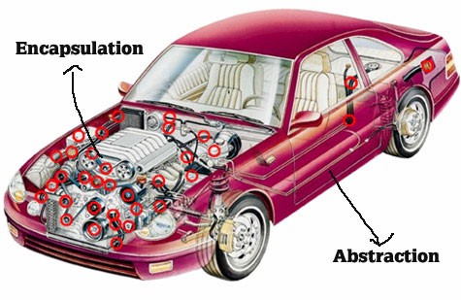
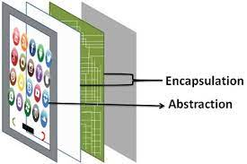
Abstraction vs. Encapsulation
Abstraction | Encapsulation
It means act of removing/ withdrawing something unnecessary. | It is act of binding code and data together and keep the data secure from outside interference.
Applied at Designing stage. | Applied at Implementation stage.
E.g. Interface and Abstract Class | E.g. Access Modifier (public, protected, private)
Purpose: Reduce code complexity | Purpose: Data protection

Slide 92

Abstract class
Abstraction is a process of hiding the implementation details from the user, only the functionality will be provided to the user.
In other words, the user will have the information on what the object does instead of how the object will do it.
Abstraction is achieved using Abstract classes and interfaces.
A class which contains the abstract keyword in its declaration is known as abstract class.
Abstract classes may or may not contain abstract methods, i.e., methods without body ( public void get(); )
But, if a class has at least one abstract method, then the class must be declared abstract.
If a class is declared abstract, it cannot be instantiated.
To use an abstract class, we have to inherit it to another class and provide implementations of the abstract methods in it.

Slide 93
Abstract class (Example)
abstract class Car {
public abstract double getAverage();
}
class Swift extends Car{
public double getAverage(){
return 22.5;
}
}
class Baleno extends Car{
public double getAverage(){
return 23.2;
}
}
public class MyAbstractDemo{
public static void main(String ar[]){
Swift s = new Swift();
Baleno b = new Baleno();
System.out.println(s.getAverage());
System.out.println(b.getAverage());
}
}
Output
22.5
23.2

Slide 94
Why Abstract Class?
Sometimes, we need to define a superclass that declares the structure of a given abstraction without providing a complete implementation.
The superclass will only define a generalized form, that will be shared by all the subclasses.
The subclasses will fill the details of every method.
When a superclass is unable to create a meaningful implementation for a method.

Slide 95
Points to remember for Abstract Class
To declare a class abstract, you simply use the abstract keyword in front of the class keyword at the beginning of the class declaration.
There can be no objects of an abstract class. That is, an abstract class cannot be directly instantiated with the new operator. Such objects would be useless, because an abstract class is not fully defined.
Cannot declare abstract constructors, or abstract static methods.
Any subclass of an abstract class must either implement all of the abstract methods in the superclass, or be itself declared abstract.

Slide 96

Interface
What to do, not how to do!

Slide 97
Interface
Definition: “Interfaces are syntactically similar to classes, but they lack instance variables, and their methods are declared without any body.”
An interface is similar to an abstract class with the following exceptions
All methods defined in an interface are abstract.
Interfaces doesn’t contain any logical implementation
Interfaces cannot contain instance variables. However, they can contain public static final variables (ie. constant class variables)
Interfaces are declared using the "interface" keyword
Interfaces are more abstract than abstract classes
Interfaces are implemented by classes using the "implements" keyword.

Slide 98
Interface (Example)
interface VehicleInterface {
int a = 10;
public void turnLeft();
public void turnRight();
public void accelerate();
public void slowDown();
}
class CarClass implements VehicleInterface
{
public void turnLeft() {
System.out.println("Left");
}
public void turnRight() {
System.out.println("Right");
}
public void accelerate() {
System.out.println("Speed");
}
public void slowDown() {
System.out.println(“Break");
}
}
Here access specifier of method must be public
public class DemoInterface{
public static void main(String[] a)
{
CarClass c = new CarClass();
c.turnLeft();
}
}
Variable in interface are by default
public, static, final
We have to provide implementation to all the methods of the interface
Output
Left

Slide 99
Interface (Example)
interface VehicleInterface {
int a = 10;
public void turnLeft();
public void turnRight();
public void accelerate();
public void slowDown();
}
class CarClass implements VehicleInterface
{
public void turnLeft() {
System.out.println("Left");
}
public void turnRight() {
System.out.println("Right");
}
public void accelerate() {
System.out.println("Speed");
}
public void slowDown() {
System.out.println(“Brake");
}
}
public class DemoInterface{
public static void main(String[] a)
{
c = new CarClass();
c.turnLeft();
}
}
VehicleInterface
CarClass
variable c is declared to be of the interface type VehicleInterface, yet it was
assigned an instance of CarClass.
Output
Left

Slide 100
Interface: Partial Implementations
If a class includes an interface but does not fully implement the methods defined by that interface, then that class must be declared as abstract.
interface VehicleInterface {
int a = 10;
public void turnLeft();
public void turnRight();
public void accelerate();
public void slowDown();
}
abstract
class CarClass implements VehicleInterface
{
public void turnLeft() {
System.out.println("Left");
}
public void turnRight() {
System.out.println("Right");
}
}
public class DemoInterface{
public static void main(String[] a)
{
CarClass c = new CarClass();
c.turnLeft();
}
}
Either class need to implement all the methods of Interface or declare that class as abstract if partial implementation is required.
public void accelerate() {
System.out.println("Speed");
}
public void slowDown() {
System.out.println(“Brake");
}

Slide 101
InterfaceHierarchy.java
class MyClass1 implements B{
public void method1(){
System.out.println("inside MyClass1:method1()");}
public void method2(){
System.out.println("inside MyClass1:method2()");
}
public void method3(){
System.out.println("inside MyClass1:method3()");
}
}
interface A{
public void method1();
public void method2();
}
interface B extends A{
public void method3();
}
interface C extends A{
public void method4();
}
class InterfaceHierarchy{
public static void main
(String[] args) {
MyClass1 c1=new MyClass1();
MyClass2 c2=new MyClass2();
c1.method1();
c1.method2();
c1.method3();
c2.method1();
c2.method2();
c2.method4();
}
}
class MyClass2 implements C{
public void method1(){
System.out.println("inside MyClass2:method1()");}
public void method2(){
System.out.println("inside MyClass2:method2()");
}
public void method4(){
System.out.println("inside MyClass2:method4()");
}
}

Slide 102
Abstract class vs. Interface
Abstract class | Interface
Abstract class doesn't support multiple inheritance. | Interface supports multiple inheritance.
Abstract class can have abstract and non-abstract methods. | Interface can have only abstract methods.
Abstract class can have final, non-final, static and non-static variables. | Interface has only static and final variables.
An abstract class can extend another Java class and implement multiple Java interfaces. | An interface can extend another Java interface only.
A Java abstract class can have class members like private, protected, etc. | Members of a Java interface are public by default.

Slide 103
Principles of OOP

Slide 104

Exception Handling

Slide 105
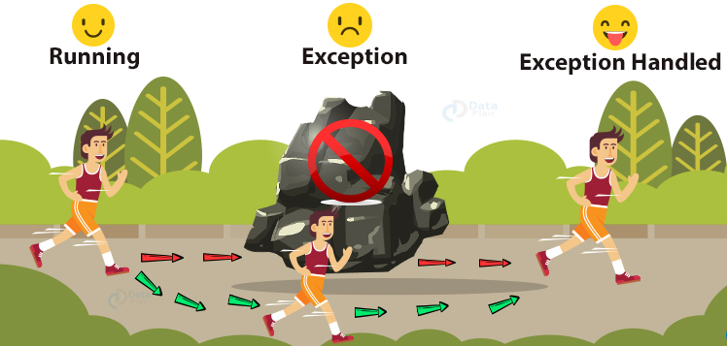
Exception Handling in Java

Slide 106
Exception Handling
Try
Catch
Throw
Throws
Finally

Slide 107
The Exception Class Hierarchy
Classes that define exceptions are related by inheritance, forming an exception class hierarchy.
All error and exception classes are descendants of the Throwable class
The custom exception can be created by extending the Exception class or one of its descendants.
LinkageError
ArithmeticException
VirtualMachineError
NullPointerException
Error
AWTError
ArrayIndexOutOfBoundsException
Throwable
Unchecked Exception
IllegalArgumentException
RuntimeException
Exception
. . .
AWTException
InterruptedIOException
IOException
EOFException
Checked Exception
FileNotFoundException
. . .

Slide 108
Mutable and Immutable Objects
The content of mutable object can be changed, while content of immutable objects can not be changed.
class MutableClass{
int a;
void add5() {
a = a + 5;
}
}
public class MutableClassDemo {
public static void main(String[] args) {
MutableClass m1 = new MutableClass();
m1.a = 10;
m1.add5();
System.out.println(m1.a);
}
}
class ImmutableClass{
int a;
int add5() {
return ( a + 5 );
}
}
public class MutableClassDemo {
public static void main(String[] args) {
ImmutableClass m1 = new ImmutableClass();
m1.a = 10;
int ans = m1.add5();
System.out.println("A in m1 = " + m1.a);
System.out.println("returned = " + ans);
}
}

Slide 109
Array of Objects
We can create an array of object in java.
Similar to primitive data type array we can also create and use arrays of derived data types (class).
class Student{
int rollNo;
String name;
public Student(int rollNo, String name) {
this.rollNo = rollNo;
this.name = name;
}
void printStudentDetail() {
System.out.println("| "+
rollNo
+" | -- | "+
name +" |");
}
}
public class ArrayOfObjectDemo {
public static void main(String[] args) {
Student[] stu = new Student[3];
stu[0] = new Student(101,"darshan");
stu[1] = new Student(102, "OOP");
stu[2] = new Student(103,"java");
stu[0].printStudentDetail();
stu[1].printStudentDetail();
stu[2].printStudentDetail();
}
}

Slide 110
What is Multithreading?

Slide 111
Life cycle of a Thread
There are 5 stages in the life cycle of the Thread
New: A new thread begins its life cycle in the new state. It remains in this state until the program starts the thread. It is also referred to as a born thread.
Runnable: After a newly born thread is started, the thread becomes runnable. A thread in this state is considered to be executing its task.
Waiting: Sometimes a thread transitions to the waiting state while the thread waits for another thread to perform a task. A thread transitions back to the runnable state only when another thread signals waiting thread to continue.
Timed waiting: A runnable thread can enter the timed waiting state for a specified interval of time. A thread in this state transitions back to the runnable state when that time interval expires or when the event it is waiting for occurs.
Terminated: A runnable thread enters the terminated state when it completes its task or otherwise terminates.
new
Program starts
thread
unlock
signal
signalAll
runnable
Thread completes
Task
await
lock
await
sleep
Interval
expires
waiting
timed waiting
terminated

Slide 112
Creating a Thread in Java
There are two ways to create a Thread
extending the Thread class
implementing the Runnable interface

Slide 113
Thread priority Constants
Thread Constants | Value
public static int MIN_PRIORITY | 1
public static int NORM_PRIORITY | 5
public static int MAX_PRIORITY | 10

Slide 114
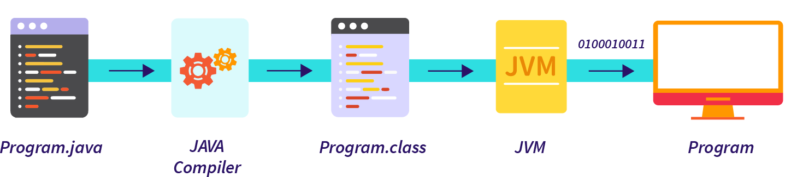
How Java execution works?
Source code (Program)
.java file
Compiler
Bytecode
.class file
JVM
(Windows)
JVM
(Linux)
JVM
(Mac)
Machine Code
Machine Code
Machine Code

Slide 115
Thank You

